Slide 1


Progressive Web Apps
A Technical Seminar
Presented by
Aravind B
1ST14CS023
Under the guidance of
Dr. T John Peter
H.O.D, Dept. of CSE
Sambhram Institute of Technology
Department of Computer Science & Engineering

Slide 2


Progressive Web Apps
Abstract
Introduction
Existing Methods & Problem Statement
Agenda
Architecture
Results and Discussions
Conclusion
References

Slide 3

Web Applications are described as cross-platform
They are accessible from a wide range and variety of devices
Majority of visitors use a smartphone to access websites.
Web apps don’t provide the experience of a native app installed on a phone
Progressive Web Apps are web apps that are designed to behave like a native app
Progressive Web Apps
Abstract

Slide 4
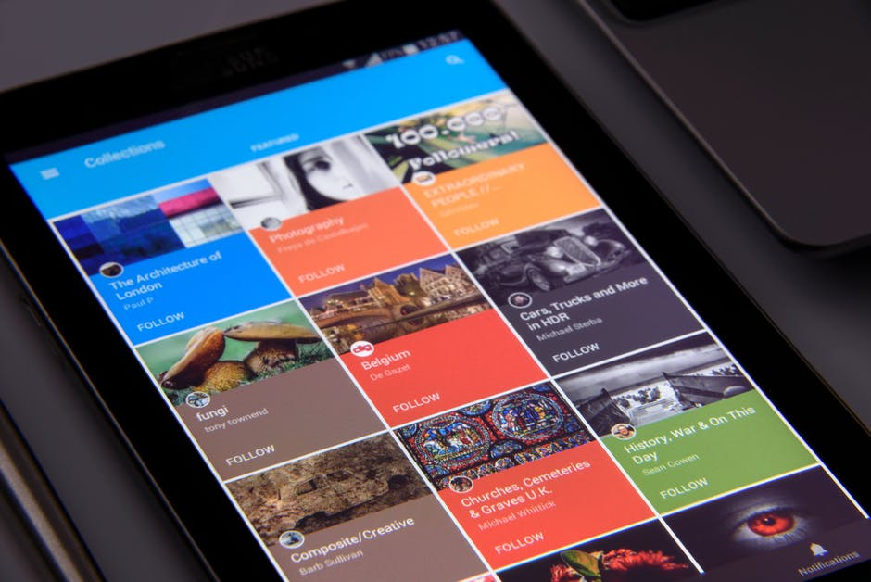
Progressive Web Apps
Introduction
Progressive Web Apps (PWAs) are web applications that are regular web pages or websites, but can appear to the user like traditional applications or native mobile applications
Originally introduced by Google in 2005, it supports offline capability, push notifications, an almost native app look and speed, and local caching of resources
Cheaper to build, less learning curve, no device
installation required
Requires no knowledge of app development

Slide 5
Progressive Web Apps
Introduction
Characteristics of PWAs
Progressive
Work for every user, regardless of browser choice
Responsive
Adapts to the device screen and auto-fits the contents
Offline
Allows offline use for users with low network connectivity
App-like
Feels like an app that was installed from PlayStore
Fresh and updated
Any changes in content should immediately be reflected

Slide 6

Progressive Web Apps
Existing Methods
The Web has shifted from static to dynamic pages and implements responsive design
Native apps provide better user experience and boot faster than web apps that take time to load
Enhancements and developments in HTML5, CSS3 and JavaScript frameworks significantly made web apps more viable.
Web apps initially failed in comparison to native apps

Slide 7
Progressive Web Apps
Problem Statement
Developers need to create different apps for different platforms
Introducing new features or updates requires development and updating all apps
They often need to create two mobile apps, one for Android and another for iOS
Maintaining multiple apps can introduce out-of-sync changes with other platforms
Developing multiple apps requires hiring multiple developers and this increases production cost
Platform-dependency may also introduce limitations on app features

Slide 8
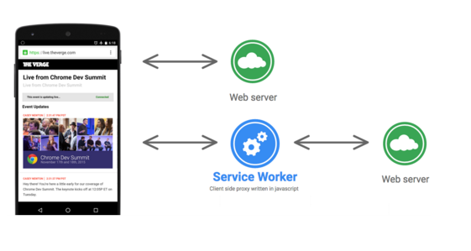
Progressive Web Apps
Architecture
Service Worker
A Service Worker is a JavaScript file that acts as a middleman between the web app and the network.
Service workers allow developers to use features such as push notifications and offline functionality
It can provide cache services, speed the app rendering, and improve the user experience

Slide 9
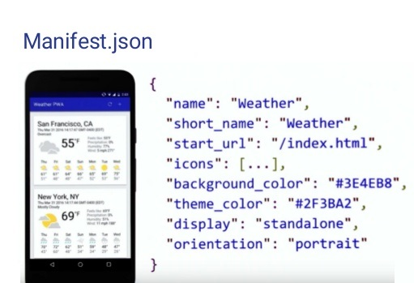
Progressive Web Apps
Architecture
App Manifest
The App Manifest is a JSON file that you can use to provide the device information about your Progressive Web App
This file will tell the device how to set:
• The name and short name of the app
• The icons’ locations, in various sizes
• The starting URL, relative to the domain
• The default orientation
• The splash screen

Slide 10
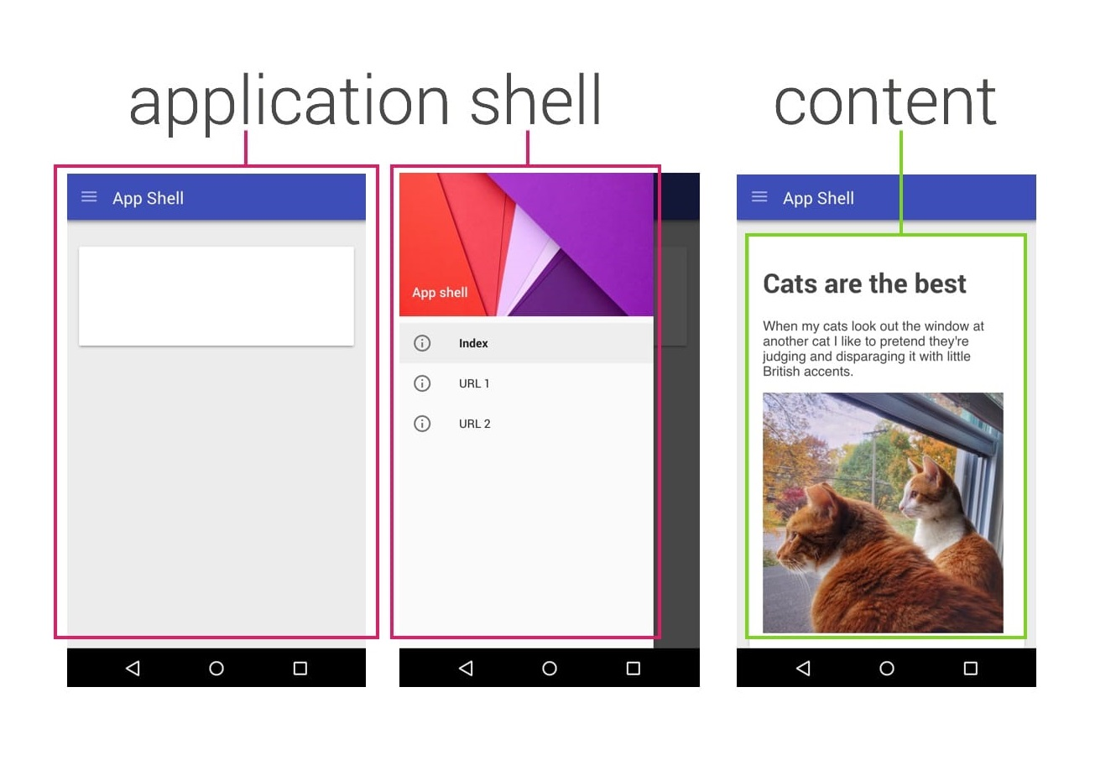
Progressive Web Apps
Architecture
App Shell
The App Shell loads and renders the web app container first, and the actual content shortly after, to give the user a nice app-like impression.
Service Workers store the Basic User Interface or "shell" of the responsive web design web application
The Shell provides an initial static frame, a layout or architecture into which content can be loaded dynamically

Slide 11
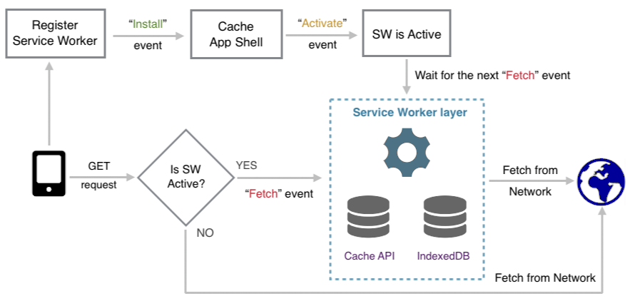
Progressive Web Apps
Overall Architecture

Slide 12
ADVANTAGES
PWA are lighter and are usually in Kilobytes
No native platform code, as apps run on browser
Updated content is readily available and doesn’t require installation
Cross-platform and developed using web technologies
DISADVANTAGES
Except Chrome, many browsers don’t fully support PWA
Limited to Android devices, not available on iOS
Not available on PlayStore, and are installed by visiting web page
Maybe unsafe, fraudulent and harmful
Progressive Web Apps
Advantages & Disadvantages

Slide 13
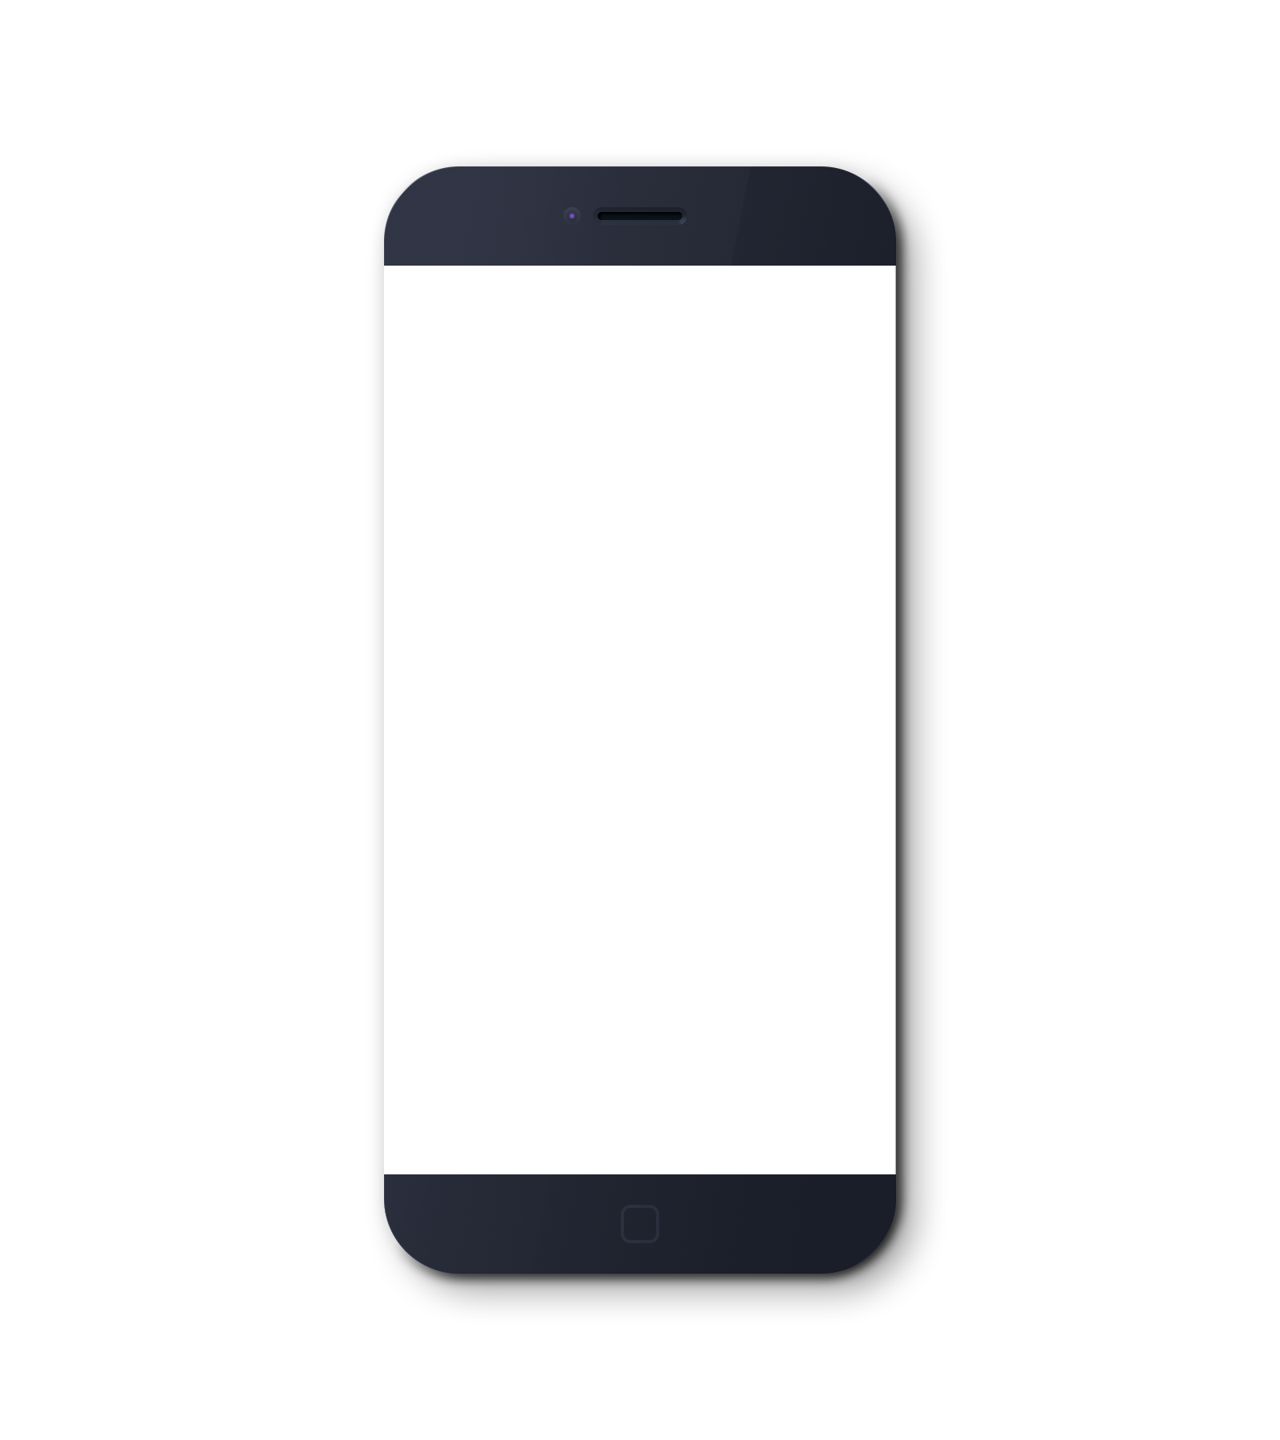
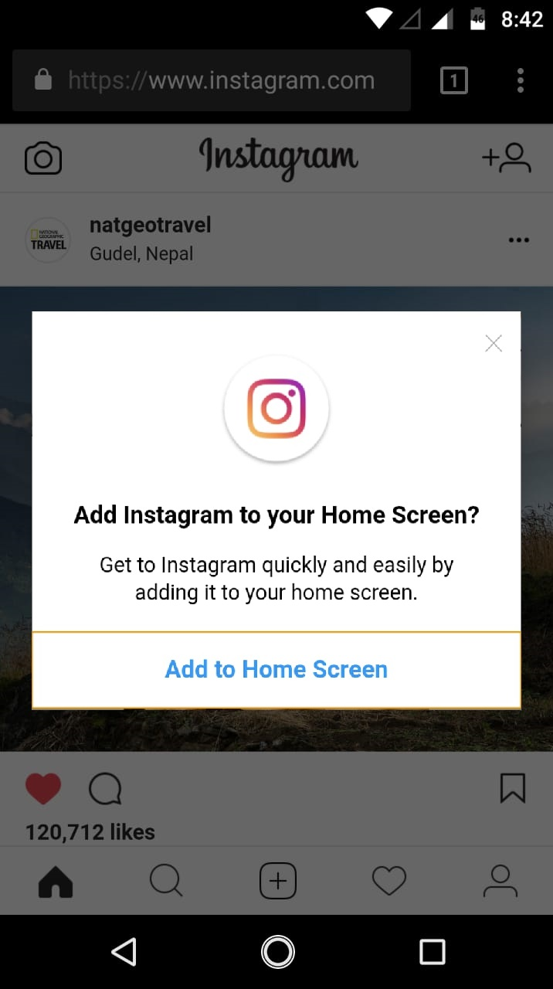

Progressive Web Apps
Results

Slide 14
Progressive Web Apps
Conclusion
Progressive Web Apps are the future of web development technologies and methods that allow us to perform our tasks on web browsers instead of our traditional native apps on mobile platforms.
PWA in brief:
Reliable Fast loading and works offline
Fast Smooth Animations, jerk free scrolling and seamless navigation even on flaky networks
Engaging Launched from home screen and can receive push notification

Slide 15
References
[1] “Comparing Progressive Web Applications with Native Android Applications” -an evaluation of performance when it comes to response time. Rebecca Fransson
[2] “An Introduction to Progressive Web Apps”. Flavio Copes
https://medium.freecodecamp.org/an-introduction-to-progressive-web-apps-6aa75f32816f
[3] “Progressive Web Apps” – Wikipedia | https://en.wikipedia.org/wiki/Progressive_Web_Apps
[4] “Progressive Web Apps” – The next step in web app development. Rajat S
https://hackernoon.com/progressive-web-apps-the-next-step-in-web-app-development-372235bf9a99
[5] “The Complete Guide to Progressive Web Apps”. Flavio Copes
https://flaviocopes.com/progressive-web-apps/
[6] “Progressive Web Apps”. Nitheesh T Ganesh
https://www.slideshare.net/iamntg/progressive-web-apps-72094520

Slide 16
Thank You
Presented by
Aravind B
1ST14CS023
Under the guidance of
Dr. T John Peter
H.O.D, Dept. of CSE
Sambhram Institute of Technology
Department of Computer Science & Engineering

